Slide 1


Some special, coffee magic
Proudly brought to you by
voldemarich & RazgrizX
On the behalf of AINA SPURDO :DDD

Slide 2
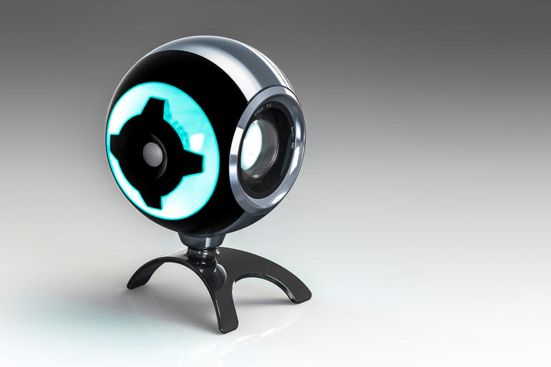

THE MIGHT OF COFFEE LEVEL KNOWLEDGE
And the ways to obtain it
Realtime
Magic :D

Slide 3
HOW WE WERE BUILDING CAMERA TRACKING
This required 5 steps:
Analyzing
Cropping
Pre-processing
Geometrical procession

Slide 4
Use of AI to predict coffee level
With data on coffee level history, it is theoretically possible to predict various things, like coffee level at certain point in time or it’s consumption rates.
There are trends and patterns in how much and when employees consume coffee. Thus, with enough data, it is possible to find them.

Slide 5
Problems of AI usage
As with any prediction, the results of the neural network won’t be accurate. This can be tolerated to a certain degree, 5-10% maximum error and 2-5% mean error won’t make any harm.
However, my research shows, that it requires considerable amount of data to achieve that. With 4500 samples for the training set and 500 for the testing set the result is not sufficient. Presence of over 20% difference between prediction and reality and 0.3-0.4 mean square error makes results much less usable that needed.
However with the 25000 training data set, the network limits has not been achieved yet.

Slide 6
Further complications
With an unreliable accuracy of neural network predictions, the unreliability of the method to accumulate data using another AI rises even more question.
There are plenty of things to go wrong with the system since it is physically divided. All this allows to use any AI related features for additional, non critical features only.
However, there is a way to solve some of the problems.

Slide 7
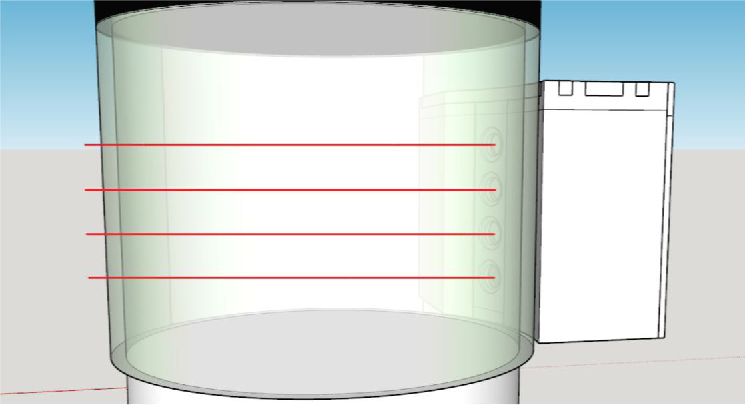
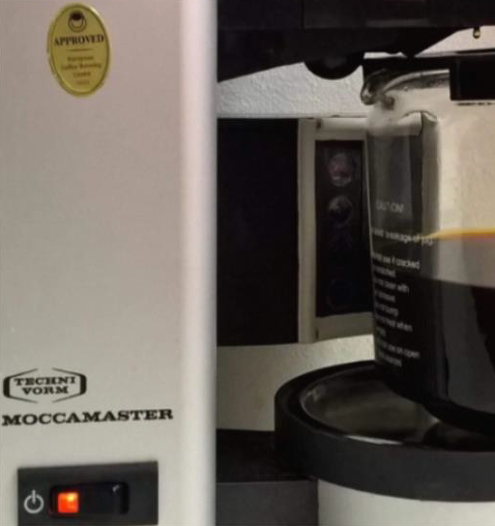
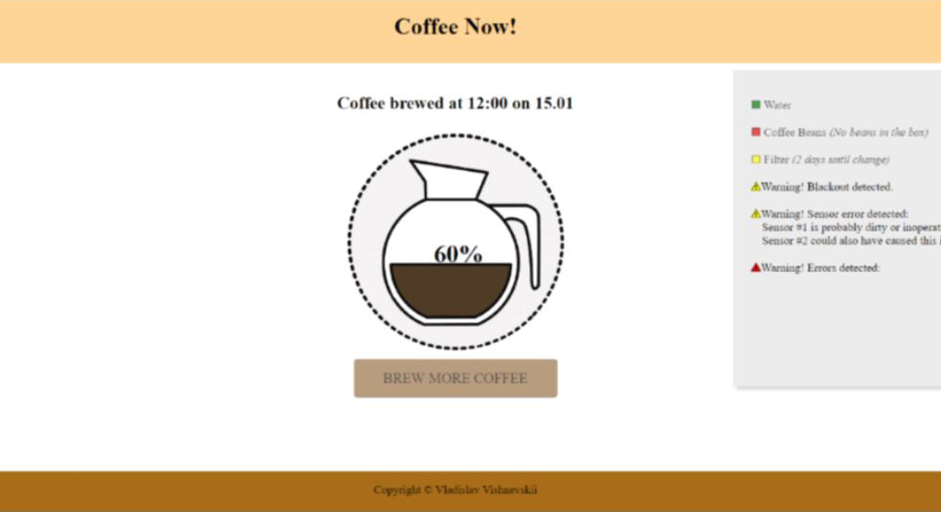
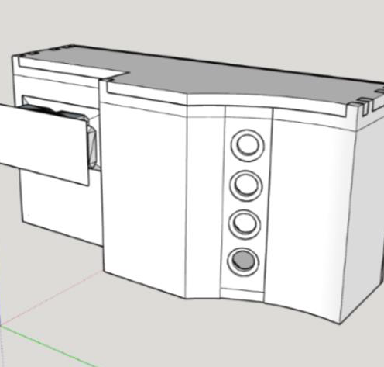
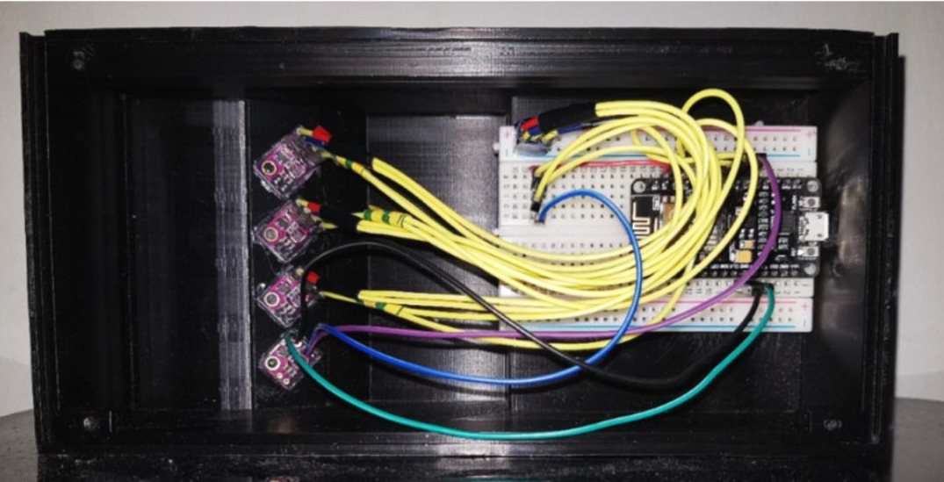
Alternative data aggregation method
With a help of optical sensors it is possible to collect less accurate, but more reliable data.
Such functionality can be connected to the existing machines or embedded into the new commercial IoT coffee machines.
They can provide data to an AI for further processing.

